Slide 1

Decoded
with Apoorv

Slide 2
AGENDA
Tries Decoded with Apoorv
Introducing Tries
Developing a Trie with Basic Data Structures
Coding a Trie
Solving questions on LeetCode

Slide 3
PROBLEMS
NUMBERS
STRING
INT
DOUBLE
CHAR
STRING

Slide 4
OPERATIONS
Number Operations
Arithmetic Operations
Logical Operations
Relational Operations
…. etc
String Operations
Concatenation
Comparison
Substrings
…. etc

Slide 5
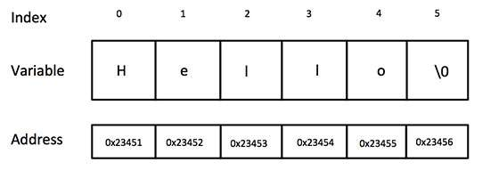
Storing a string
string s;
string s(10,’a’);
string s = “Hello”;

Slide 6
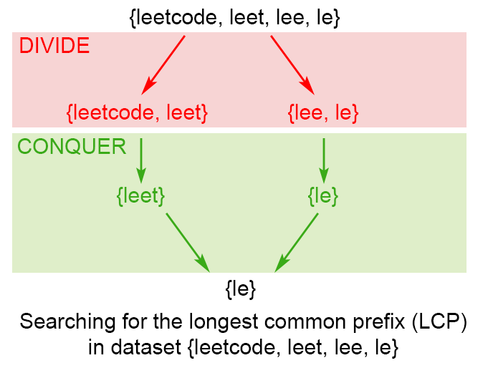
Problems
Search for common prefixes:

Slide 7
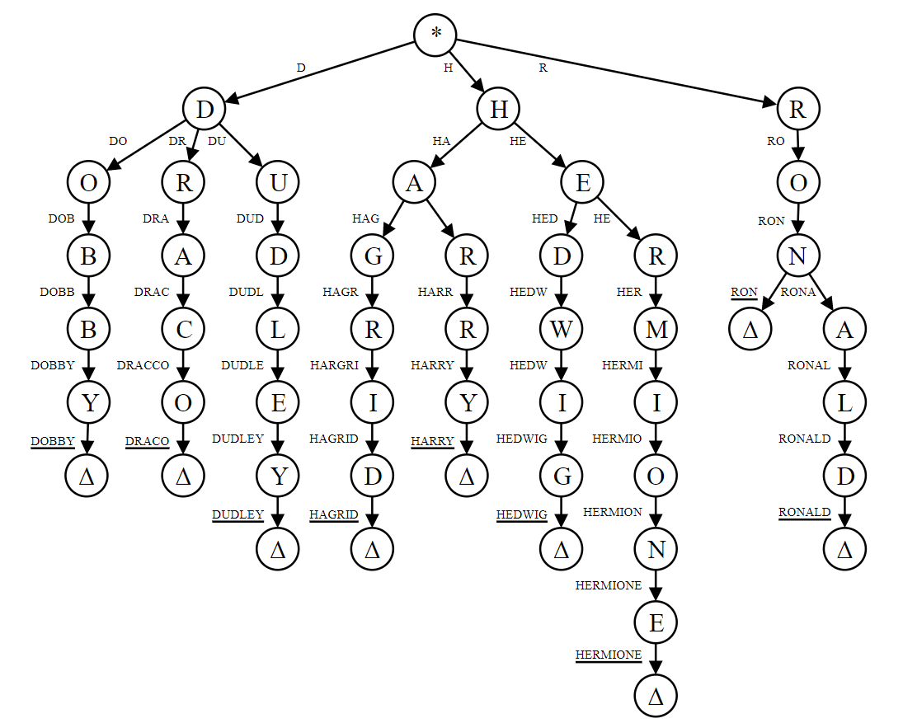
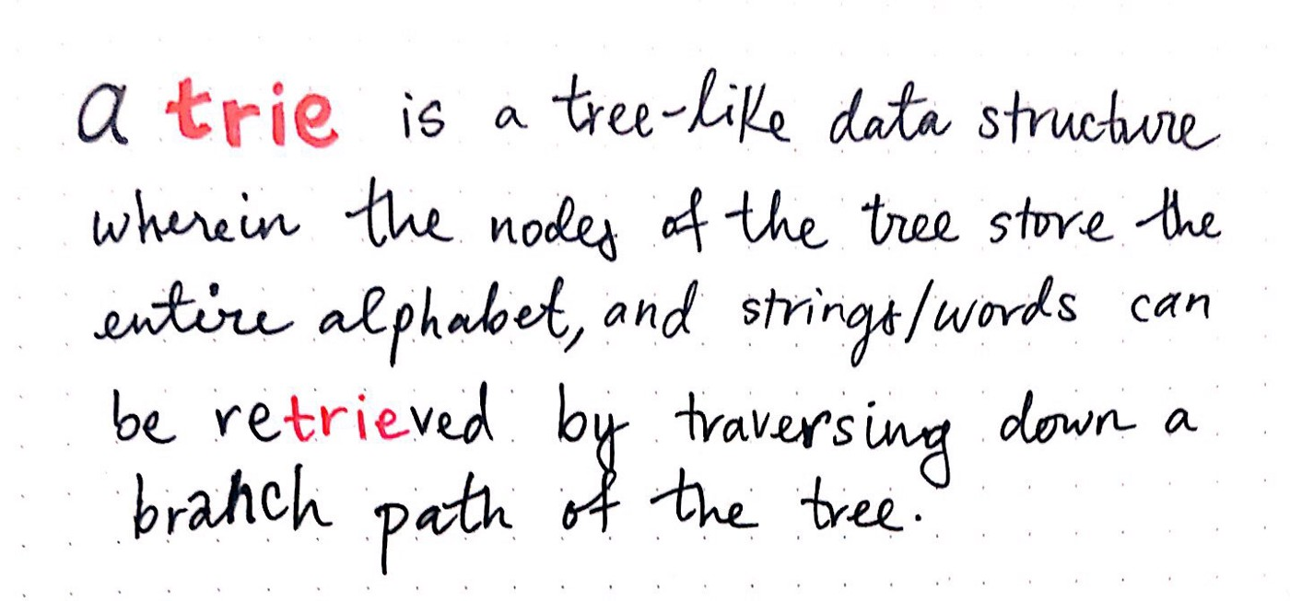
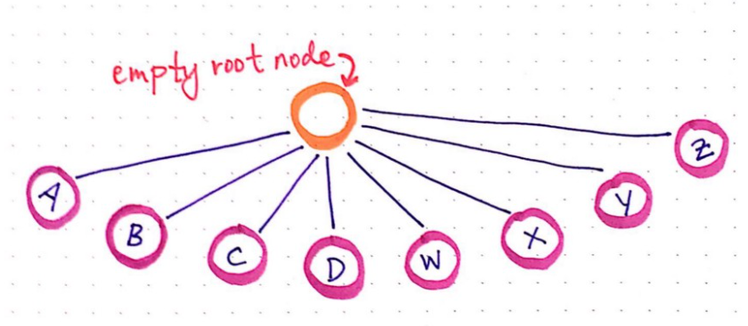
. Tries .

Slide 8
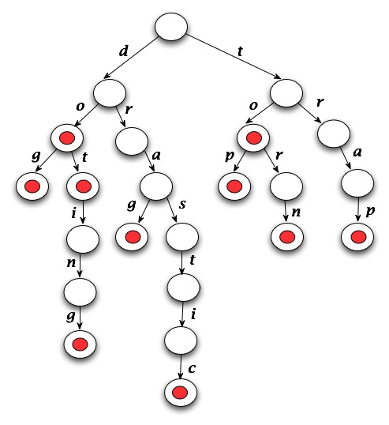

Slide 9
Questions
Trie
L208
(Implement Trie Prefix Tree)
L1233
( Remove Sub-Folders from the Filesystem )
L692
( Top K Frequent Words )
Trie + Recursion
L211
(Design Add and Search Words Data Structure)
L386
( Lexicographical Numbers )

